Slide 2
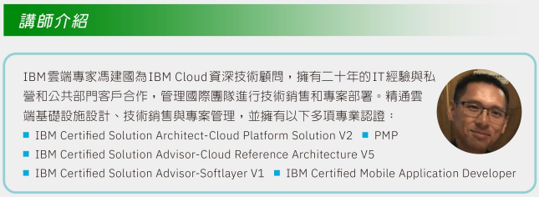

Slide 3
IBM Cloud 服務介紹
IBM Cloud Unit
雲端專家
馮建國 (Gordon Fung)

Slide 4
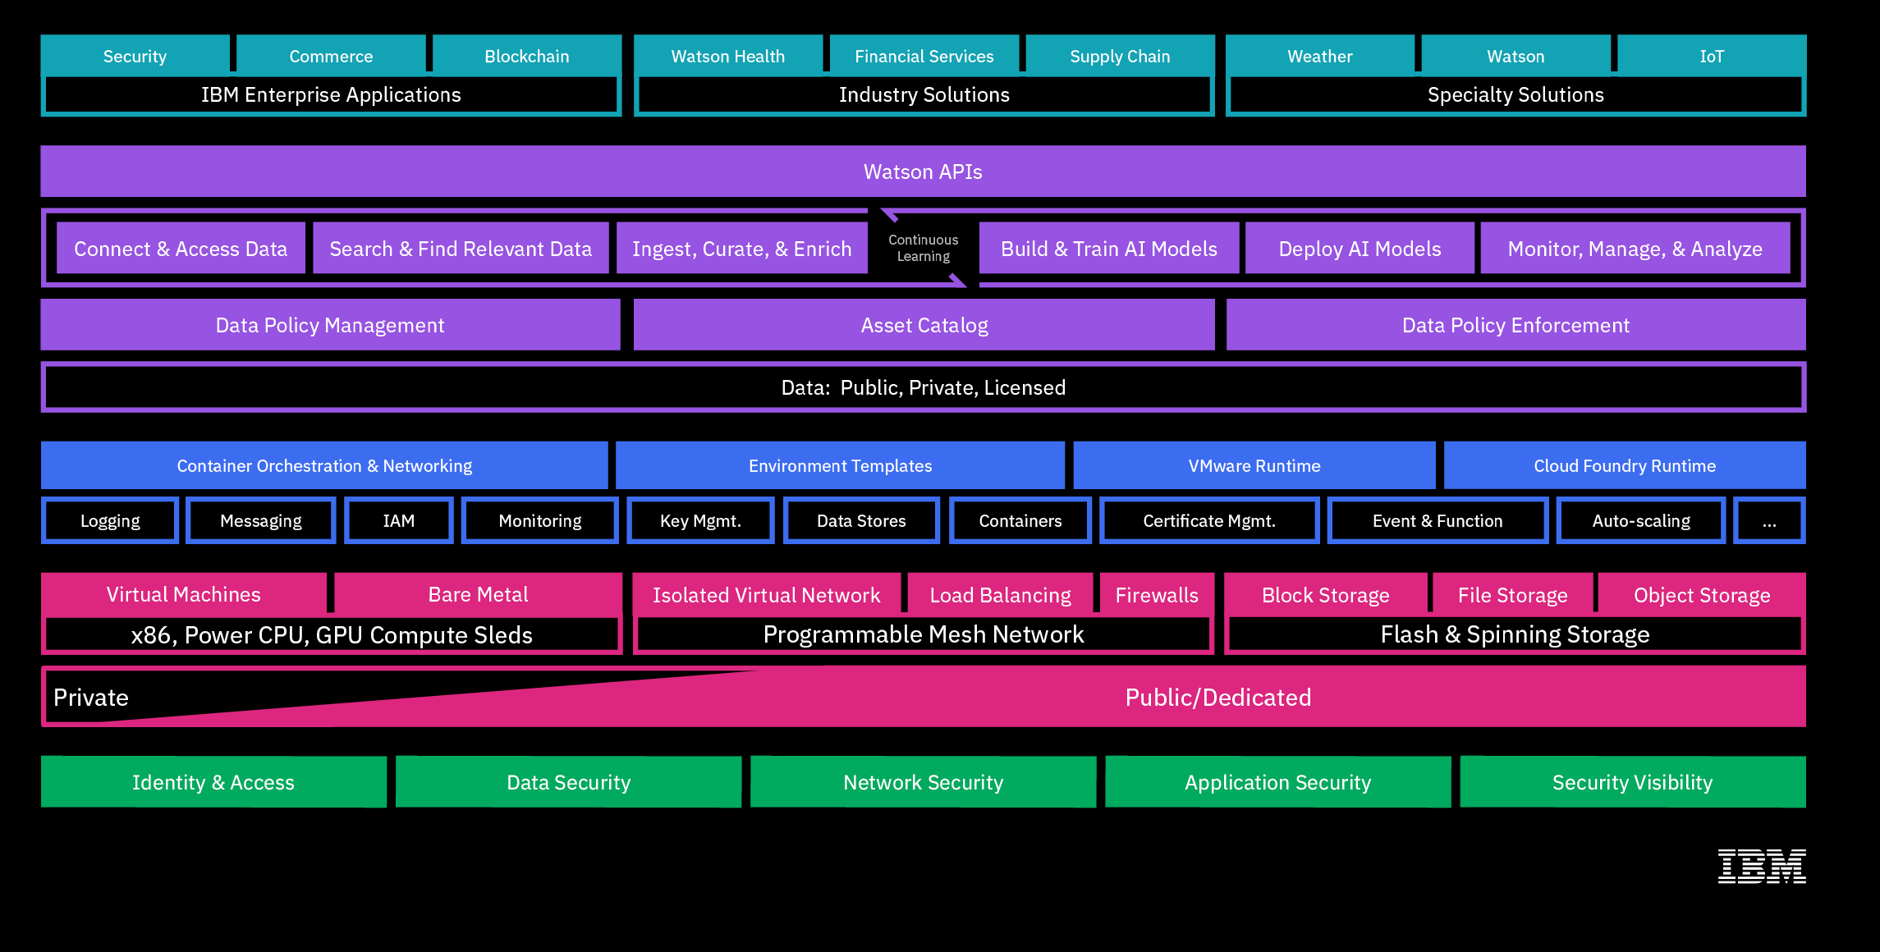
IBM Cloud One Architecture
Notes:
In order to provide the best Enterprise Cloud, we’ve brought together IaaS, Dev Services, Data & AI under One IBM Cloud with greater scalability and consistency and a full stack platform of a truly enterprise grade set of capabilities purpose built for Data & AI workloads.
By bringing together all of IBM Cloud into One Architecture, built and run by one team and engineering a consistent set of infrastructure and services, IBM is providing a single Cloud stack for use across private, and public deployment models all focused on bringing together the best Enterprise Cloud capabilities in the market.

Slide 5
IBM Cloud – full stack platform for cloud-native apps
IBM Services
AI
Analytics
Application Services
Business Process and Operations
Business Resiliency Services
Business Strategy and Design
Cloud Services
Digital Workplace Services
Network Services
Security Services
Technology Consulting Services
Technology Support Services
Watson Studio
Watson Knowledge Catalog
Watson Assistant
Watson Discovery
Watson Language Translator
Watson Nat. Language Classifier
Watson Nat. Language Understanding
Watson Speech to Text
Watson Text to Speech
Watson Personality Insights
Watson IoT Platform
Data Refinery
Watson Machine Learning
Deep Learning
Analytics Engine
Apache Spark
Decision Optimization
Db2 Warehouse on Cloud
Master Data Mgmt. (MDM) on Cloud
Information Server on Cloud
Streaming Analytics
Security
DevOps
Mobile
Activity Tracker
App ID
Network Security
SSL Certificates
Certificate Manager
Hardware Security Module
Hyper Protect Services
Identity Access Mgmt.
Continuous Delivery
Continuous Release
Globalization Pipeline
Cloud CLI
Availability Monitoring
Cloud Developer Console for Apple
Cloud Event Management
Workload Scheduler
DevOps Insights
Log Analysis
Monitoring
Multi Cloud Manager
Mobile Foundations
App ID
Mobile Analytics
Push Notifications
Databases
Integration
VMWare
IoT
Cloudant
IBM Cloud DBs
Db2 Hosted
Db2 on Cloud
Db2 Warehouse
Informix on Cloud
Lift
Mass Data Migration
API Connect
App Connect
Aspera on Cloud
Event Streams
MQ on Cloud
IBM Cloud DB for Rabbit MQ
Direct Link
Secure Gateway
Secure Virtualization
Veeam on IBM Cloud
VMWare Horizon on IBM Cloud
Skytap on IBM Cloud
F5 on IBM Cloud
Fortinet on IBM Cloud
Spectrum Protect Plus on IBM Cloud
Zerto on IBM Cloud
IoT Platform
Weather Data APIs
Compute
Networking
Storage
Bare Metal Servers
Cloud Virtual Servers
Mass Storage Servers
IBM Cloud Private
Container Registry
Kubernetes Service
Cloud Foundry
Cloud Functions
IBM Cloud Dedicated
WAS on Cloud
Auto Scaling
VMWare Cloud Solutions
SAP-Certified Infrastructure
Internet Services
Virtual Router Appliance
DNS
CIS
CDN
Load Balancing
Direct Link
Network Security
Block Storage
File Storage
Object Storage
EVault
Notes:
IBM Cloud offers a comprehensive suite of Enterprise-grade services ranging from bare metal, containers and serverless computing to hyper scale infrastructure, blockchain, AI/ML and HP, all with built in security at their core.
IBM gives you a platform to go to market faster, respond to changes in the market and solve business problems.
Continuous availability for all solutions built
* Tools to build new apps
* A platform to host
* Enabled with services like AI & data
* Security for global deployment
3 scenarios
-Modernize existing apps: bring to cloud & extend with new services
-Migrate: take as is & lift to the cloud
-Build new apps: start from scratch using cloud native architectures
Paas is the critical layer: build new apps on cloud, run on top of infrastructure, take advantage of network & storage
services, leveraging numerous APIs & capabilities to deploy
Heart of PaaS architecture is containers & Kubernetes
-Kubernetes is a management system to run containers & has become the industry standard to build & modernize apps
-Containers are surrounded by networking & security, providing a foundation to run apps directly & have more specific models
-Faas: event-driven serverless apps
-Cloud Foundry: build web apps
-Messaging with Kafka,
-Log & monitoring: know what’s going on
This collection of services provides the platform for you to use to build modern apps

Slide 6

IBM Cloud Infrastructure
Designed for your data.
AI ready.
Secure to the core.
IBM Cloud is the cloud for business.

Slide 7




A cloud infrastructure that meets you where you are and takes you where you want to go
Customized
Best-in-class, powerful compute, storage, & network infrastructure for any workload and any budget size — from born-on-cloud to Fortune 500 enterprises
Open
First to build on a foundation of open source (Kubernetes, OpenWhisk, Cloud Foundry), paving the way for others
Trusted
Expertise in over 20 industries, standardized approach for auditable consistency, and global and regulated industry compliance
Visionary
First to see and build for future-proofing with Watson — the oldest AI at 7-years-old —blockchain, and a single architecture platform

Slide 8
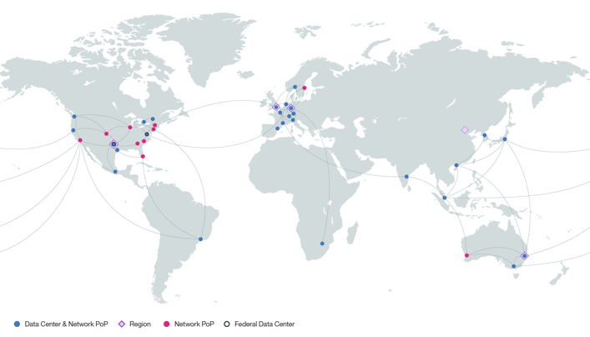
Data Centers: Globally local
Built with multiple deployment options for your unique workload needs Choose where to deploy from nearly 60 locations in 19 countries
“The ability to access IBM’s global network of cloud data centers, which are all connected by a high-speed fiber network, is extremely attractive to us.” -Rob Platzer, chief technology officer, Bitly

Slide 9
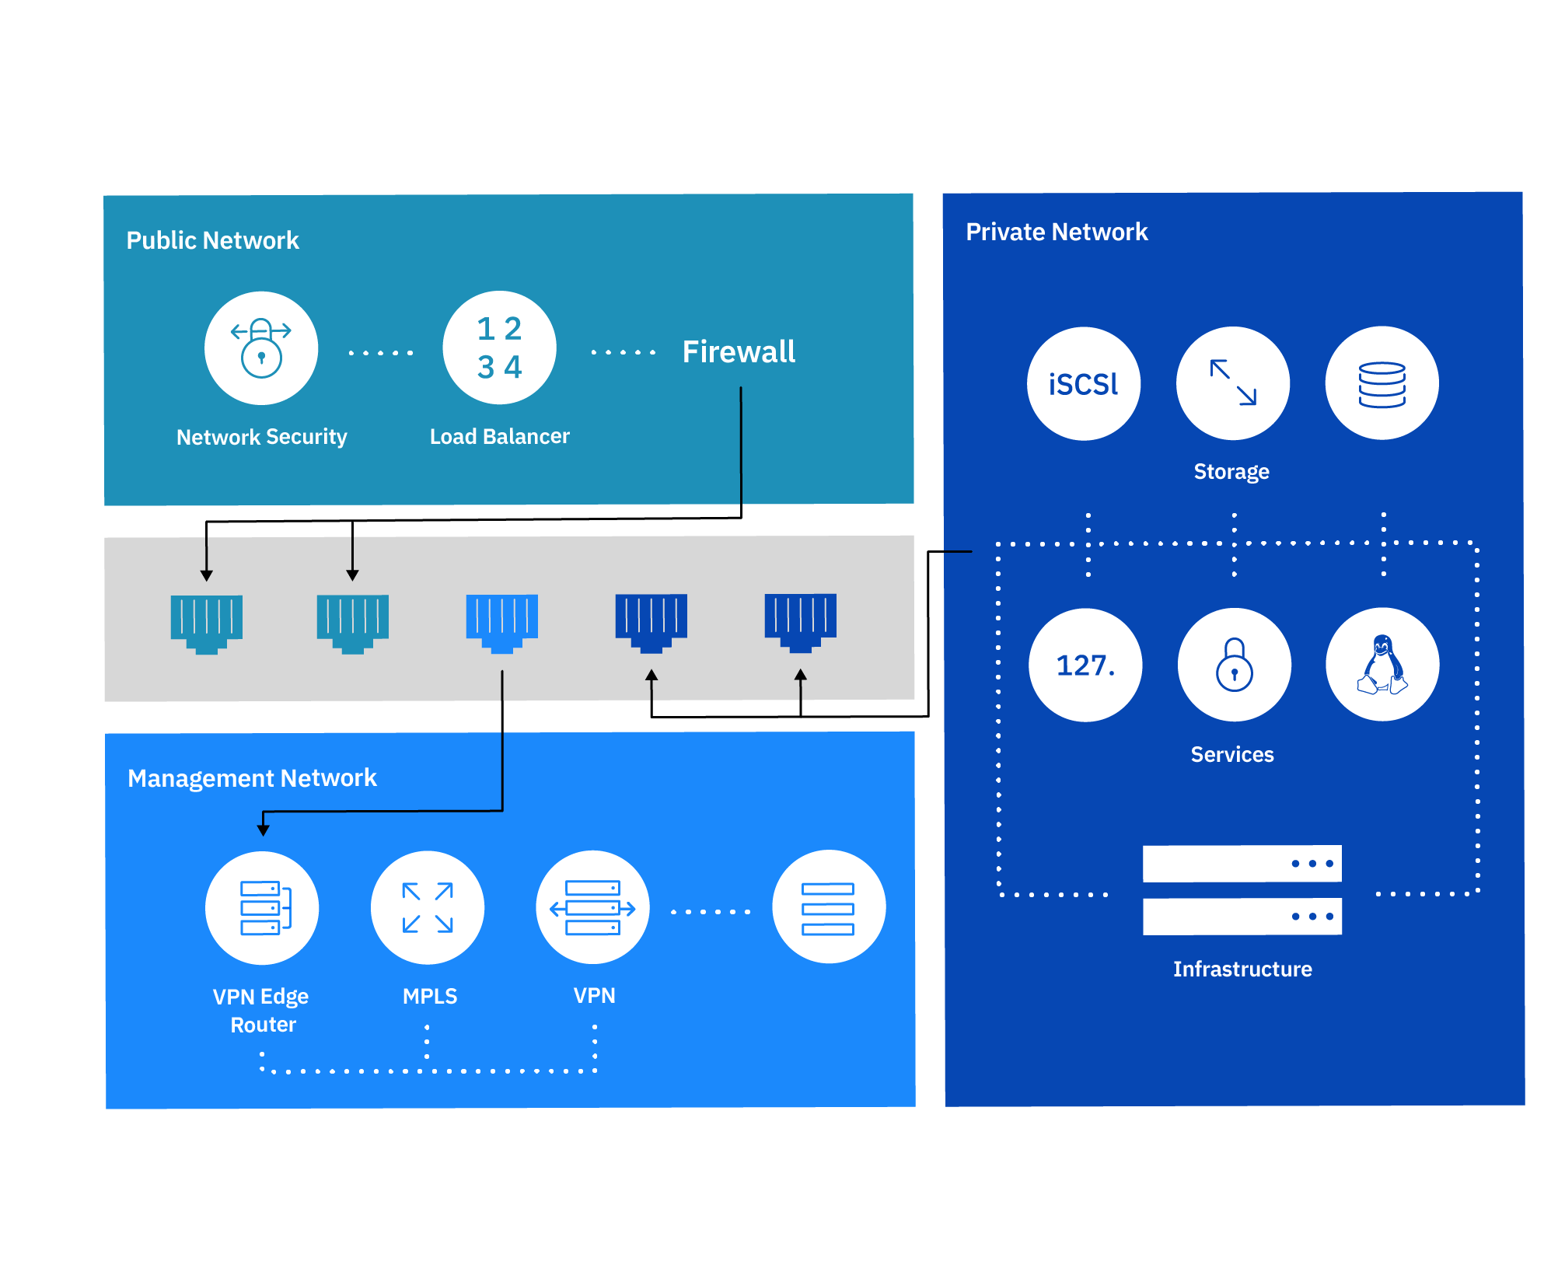
Unique, triple-layer network architecture
Public, private, and management traffic travel on separate networks, giving you unmatched control, security, and speed. The private network connects your services in all data centers, free of charge.

Slide 10
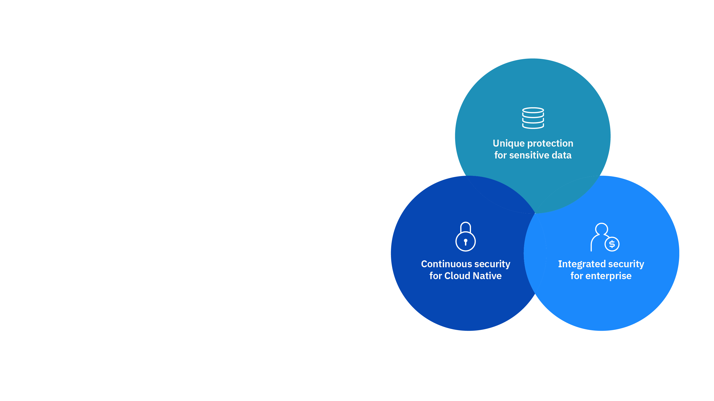
End to end security for cloud native and enterprise workloads
Secure to the core: Technology
Comprehensive cloud security offering portfolio
API ready services for cloud integration

Slide 11
End to end security for cloud native and enterprise workloads
IBM Cloud Security
Security
Management
Data Protection
Secure to the core: Expertise
Deep security and regulatory compliance expertise
Managed services for security operations and intelligence
Network Security
Identity & Access
Secure DevOps
Security Visibility

Slide 12




Infrastructure-as-a-Service Highlights
Smart partnerships for a better cloud
VMware, SAP, and Intel power cloud for the custom workloads your business needs
Built for security
High assurance, enterprise-strong cloud security portfolio and expertise to help you adopt IBM Cloud with confidence
Fast provisioning
Spin up bare metal or virtual servers in 30 minutes or less, with network offerings that provide consistent, cutting edge computing speeds
Power and performance
13 Tbps connectivity on a low latency, high resiliency global network with powerful bare metal and VM compute performance

Slide 13
Compute

Slide 14


A high performing cloud starts with a strong compute foundation
Choose a server type
Compute options from high-abstraction to high-control
Customize to suit your workloads
Pre-configuration to fully customizable server options
Provision on demand
Deploy an IaaS bare metal or virtual server in minutes and customize bare metal in 2–4 hours

Slide 15
Compute Infrastructure
SAP Certified Servers
Build, deliver, and run SAP applications in the cloud
Bare Metal Servers
Raw IaaS horsepower for processor-intensive and disk I/O-intensive workloads
Virtual Servers
Fast deployment when resources are needed on the fly
GPU Computing
Handle complex, compute-intensive workloads, including analytics, graphics, and AI
POWER Servers
Develop, test, and run Linux applications
Server Software
Operating systems to control panels to simplify IaaS administration

Slide 16
Bare Metal Servers

Slide 17
Bare Metal Servers
High-performance computing
Solve problems faster
Secure data
Match data security needs — previously available with on premise servers only
Real challenges and real solutions
High volume data
Gather and store, analyze data, and gain insights to make better business moves
AI
65% more machine learning with latest GPUs to find new value in your data

Slide 18





Bare Metal Servers Family Benefits
Choice with Consistency
Bare Metal servers are available in all data centers
Hybrid Integration
Customize Bare Metal to look exactly like your on premise solution or add to it
Powerful, Accessible Data & Analytics
Use Bare Metal servers for high performance data and analytics workloads
DevOps Productivity
Use Bare Metal servers for high performance needs in production environments
Cognitive Solutions
Use Bare Metal servers for high performance Cognitive solutions

Slide 19


Bare Metal Servers
The power you demand for your processor — and disk I/O-intensive workloads
Performance: Eliminates multi-tenant resource conflicts with competing work streams
Control: Complete control of physical hardware
Power from the ground up — dedicated to you.
Solve problems faster
Powerful
On-demand
Customizable

Slide 20
Bare Metal Processor Options
Single Socket
Ideal for:
Entry-level web hosting
Development sandbox
Simple email servers
Dual Socket
Ideal for:
Hosting resellers
Moderately-sized websites
SMB back office apps
Quad Socket
Ideal for:
High transaction apps
Virtualization
Disaster recovery
Octo Socket
Ideal for:
Everything quad socket servers offer plus in-memory computing with large database applications. Only available with SAP offering.
IBM Cloud/ © 2019 IBM Corporation

Slide 21
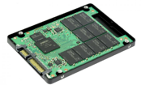
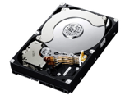
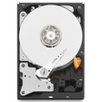
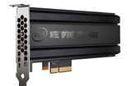
Bare Metal Hard Drive Options
SSD SED High performance, low latency, enterprise-class storage Drive capacities up to 3.8TB Ideal for high-performance and data-intensive applications | SAS Includes 3.0Gb/s interface with 16MB cache and 15K RPM rotation speeds High performance speed and reliability Ideal for gaming, database, streaming media, and mission-critical servers | SATA Each unit includes up to 6.0Gb/s interface with 64MB cache (SATA III) Drive capacity ranges 1TB to 10TB Each unit includes up to 6.0Gb/s interface with 64MB cache (SATA III) Ideal for web, mail, or high-capacity storage servers | 3D XPoint™ Technology High performance cell and array architecture that can switch states 1000x faster than NAND 10x denser than conventional memory Storage and memory converged

Slide 22
SAP Certified Servers for HANA and Applications
SAP Certified HANA servers
8 Socket 8890v4 4, 8, 12* TB RAM
4 Socket 8890v4 1, 2, 4, 6* TB RAM
2 Socket 6140 192, 384, 768 GB RAM
SUSE SLES 12 SP2 RHEL 6.7, 7.4 for HANA VMware 6.0, 6.5
SAP Certified NetWeaver servers
4 Socket 8890v4 1 TB RAM | 1 Socket 1270v6 32, 64 GB RAM
2 Socket 6140 192, 384, 768 GB RAM | 1 Socket 1270v6 32, 64 GB RAM
2 Socket 2690v4 512 GB RAM | SUSE SLES 12 SP2 RHEL 6.x or 7.x Windows Server
2 Socket 2690v3 128, 256 GB RAM | DB2, MSSQL VMware 6.0, 6.5
Other Components
Network Gateways HW or SW options
Firewalls HW or SW options
Backup Veeam, Object Storage, Endurance Storage
Virtual Servers BOBJ, AD, Jump, Dev/Test

Slide 23
Virtual Servers

Slide 24
Virtual Servers
Dynamic Workloads
Not all workloads are the same—some require different resources
Small, medium, large sizes
Various isolation types
Data stored where you need
Flexibility
Allows for dynamic resizing depending on data
Fast provisioning times
Hourly or monthly models
Real challenges and real solutions
Predictability
High and predictable performance
No oversubscription of vCPU or RAM
Guaranteed 2.0 GHz or faster

Slide 25




Virtual Servers Family Benefits
Ease of use
Improved selection process from a broader spectrum of public virtual server flavors
Lower provisioning times
Pre-configured virtual servers based on workloads to easily select a best fit
More control and visibility
Single tenant virtual server offerings allow clients in heavily regulated industries overcome cloud adoption barriers
Cost savings
Servers dedicated to specific workloads to minimize under- or over-utilized resources

Slide 26

Virtual Servers
Quickly deploy and scale cloud infrastructure on demand
Flexible
On-demand
Powerful
Real challenges and real solutions
Virtual servers give you the ability to change your cloud environment as fast as business moves.
Choice: Single-tenant eliminates resource conflicts. Hourly and monthly options for short-term and long-term applications.
On-demand: Provision virtual servers in minutes to combat workload spikes.
Performance: 2.0Ghz or faster with no oversubscription on core or RAM.

Slide 27
Public
Multi-tenant offering with rapid provisioning and scalability
Dedicated Instance
Single tenant offering with rapid provisioning, allowing further control and flexibility in virtual server deployments
Dedicated Host
Virtual servers dedicated to customers providing the most control by enabling workload placement and flexibility in virtual server deployments
Virtual servers give you fast access to compute resources to meet any workload
Virtual Servers

Slide 28
Virtual Server Families and Applications
Balanced
Common cloud workloads requiring a balance of vCPU and RAM
Compute
Front end, batch-processing workloads, requiring more compute than memory
Memory
Caching, in-memory, database solutions, requiring more memory than compute
Balanced Local
Common cloud workloads requiring a balance of vCPU and RAM along with local storage (SSD and HDD options) and performance

Slide 29
GPU Computing

Slide 30
GPU Computing
AI
Add GPUs to enable up to 65% more machine learning than traditional servers*
Big Data
Take on massive data analytics computations
Real challenges and real solutions
GFX Applications
Get blazing speeds for graphic-intensive workloads like 3D CADs and data rendering for gaming

Slide 31

GPU Computing Benefits
The processing power for high performance computing, deep learning, machine learning, AI, Virtual Desktops (VDI):
Powerful: Solve complex problems faster and with less power than CPUs
Fully integrated: GPUs seamlessly integrate into our cloud infrastructure, API, and management tools

Slide 32
GPU Computing
NVIDIA Tesla P100/K80
Applications: AI, deep learning
Get up to 50x performance over the Tesla K80
Enable up to 65 percent more machine learning*
NVIDIA Grid K2
Applications: Professional-grade graphics
Ramp up any graphics applications that require blazing speed
NEW Now available by the hour
NVIDIA Tesla M60
Applications: Data analysis, scientific computation
Massive data analytics computations
NEW Now available by the hour

Slide 33
GPU Computing use cases
Virtual desktop infrastructure
Scale, secure, standardize, and provide enhanced performance with GPU enabled offerings
Financial services
Performing large and complex ﬁnancial transactions
Gaming
Process and render data and graphics for high game performance
Scientiﬁc research
Solve complex molecular modeling calculations or analyze massive amounts of seismic data
Healthcare
Log on to your desktop from any workstation within the network facility without slowing down trafﬁc
Graphic design
Experience smooth, multimedia-rich applications, including 3D-intensive programs

Slide 34
Direct Link

Slide 35
Direct Link
Native access to key Resources
With a high speed, direct network link between your data centers and ours, you can move data between servers at the speed of light– plus access key resources such as AI, blockchain, IoT, and more
Hybrid Workload
Support
On-prem apps run off-premises on a public cloud that analyzes data stored on-premises due to residency requirements.
Real challenges and real solutions
Super Secure Data Transfer
Moving sensitive data to and from our cloud platform further ensures its security by completely avoiding exposure to the public internet at all times.
Leverage existing IT investments
IT modernization is the top driver of public cloud adoption, followed by cost savings. Do both by leveraging existing investments while emphasizing cost savings.

Slide 36

Direct Link
IBM Cloud Direct Link helps ensure the security of sensitive data to and from the IBM Cloud. Back up or store huge volumes of data from your data center on IBM Cloud with predictable bandwidth costs. With a dedicated network connection, your transfer rates are fast, consistent and reliable.
Faster speed, lower latency: Move data to and from your data center across network connections at speeds up to 10Gbps.
Higher security: Protect your sensitive, business-critical data by controlling every network hop.
More reliability: Receive consistent, higher-throughput connectivity between a remote network and your IBM Cloud environments.

Slide 37
Network Security

Slide 38
Network Security
E-commerce, Payment card industry
Businesses with security compliance requirements may require additional firewall layers between each tier of your network
Healthcare,
Financial Services
Achieve regulatory compliance, improve efficiency, and enhance overall asset management by condensing the number of security groups
Real challenges and real solutions
Small-Medium Business
81% of all data breaches happen to SMBs*, so protect data with a security plan that lets you control, deploy, and provision network security features quickly
Improved Migration Options
Leverage the WanClouds third-party Configuration Conversion tool to assist in migration from our legacy Vyatta 5400 offering to IBM Cloud Virtual Router Appliance

Slide 39
Network Security Options
Shared Hardware Firewall
Protection for single servers provisioned on demand without service interruptions.
Dedicated Hardware Firewall
1Gbps, single-tenant protection for servers that share the same VLAN
Provisioned on demand without service interruptions
FortiGate® Security Appliance 10Gbps
Single-tenant firewall for multiple VLANs on public and private networks
Provides access to add-ons such as intrusion prevention, anti-virus protection, and web filtering
Security Groups
Value-added network security solution
Define security policies at the instance level
No support for bare metal

Slide 40

Shared Firewall
A shared hardware firewall leverages a multi-tenant enterprise platform to protect an individual server. It delivers virtualized network security through its virtual domain (VDOM) technology, providing separately provisions and managed virtualized security domains.

Slide 41

IBM Cloud – Dedicated Firewall
A dedicated firewall leverages a single-tenant appliance to protect any or all servers on a public VLAN. It can be added to a public VLAN at any time. Firewall rules are applied on a per-IP or per-subnet basis.

Slide 42

FortiGate® Security Appliance
Make network security your first line of defense.
A FortiGate® Security Appliance (FSA) is a dedicated single-tenant network device connected upstream from a server and protects any or all servers on a public VLAN.
Our FortiGate Security Appliance 10Gbps offering offers up to 10Gbps on both public and private VLANs for robust perimeter security.

Slide 43

Security Groups
Security groups are a value-added, zero cost solution that easily add instance-level network security to manage incoming and outgoing traffic on both private and public networks.
Enhanced, instance-level control
Scalable and customized for your needs
You set ingress and egress filtering

Slide 44
Which Firewall is for me?
Offerings
 | Security Groups | Shared Hardware Firewall | Dedicated Hardware Firewall | FortiGate Security Appliance | FortiGate Security Appliance 10 Gbps
Stateful Packet Inspection | Yes | Yes | Yes | Yes | Yes
Customer managed appliance | No | No | Yes | Yes | Yes
VLAN Protection | No | No | Yes | Yes | Yes
Ingress Rules | Yes | Yes | Yes | Yes | Yes
Egress Rules | Yes | No | No | Yes | Yes
NAT Support | No | No | No | Yes | Yes
Multi-VLAN Support | No | No | No | No | Yes
DMZ and Multi-Tiered Network Support | No | No | No | No | Yes
Public and Private Network Support | Yes | No | No | No | Yes
SSL VPN Termination | No | No | No | Yes | Yes
IPsec VPN Termination | No | No | No | Yes | Yes
Open VPN Termination | No | No | No | No | No
HA Option | N/A | No | Yes | Yes | Yes
Manage from API & Portal | Yes | Yes | Yes | Appliance GUI | Appliance GUI
10Gbps Support | N/A | No | No | No | Yes
NGFW Add-ons (IPS, AV, WAF) | No | No | No | Yes | Yes
Features
Notes:
This should be a “guide” to help customers :
understand the offering and
help customers select the best option for them.

Slide 45
Storage

Slide 46

Block and File Storage
Now with monthly and hourly billing.
Deploy full-featured, Flash-backed¹ block storage in granular increments — from 1,000GB to 12,000GB — with customizable deployments, IOPS, and billing.
Go global: Provision block storage alongside your cloud servers in IBM Cloud data centers worldwide.
Easy to work with: Stay confident with a higher class of block storage designed to protect, simplify, and cater to your changing needs.
Get predictable billing: Lock in your costs by the month or by the hour, without the surprise of hidden fees or additional charges.

Slide 47
Block and File Storage
20GB to 12TB storage | Max of 48,000 IOPS(2) | Monthly and hourly billing
Block
Local disk performance with SAN persistence and durability.
Choose your deployment:
Endurance tiers: Specify capacity only (IOPS and throughput scale with volume size). Pre-defined for simplicity. Ideal for most workloads.
Performance options: Specify both capacity and IOPS. Ideal for workloads with well-defined performance requirements.
Example: 500GB volume @ 2 IOPS
500GB * 2 IOPS/GB tier = 1,000 IOPS total
1000 IOPS * 16kb block size = 16MB/s throughput
$0.20/GB * 500GB = $100/month
Example: 500GB volume with 250 IOPS
250 * 16kb block size = 4 MB/s throughput
$0.10/GB * 500 GB + $0.07/IOP * 250 =
$50 + $17.50 = $67.50 / month
IBM Cloud/ © 2019 IBM Corporation

Slide 48
Block and File Storage Industry essentials come standard
Block
Local disk performance with SAN persistence and durability.
At rest data encryption: Disk level with provider managed keys(5)
Expandable volumes/adjustable IOPS: Accommodate dynamic workload needs on the fly
Flash-backed: Decreased latency/increased throughput(1)
Max durability: Maintain availability and integrity through events without RAID arrays
Granular volume sizes: Lower your costs with TB increments
Customizable IOPS: Tailor assigned levels of IOPS tiers and customizable IOPS for top performance
Hourly or monthly: Create short-term use storage volumes for Dev/Ops, DR testing, etc.(3)
Snapshots and replication: Non-disruptive and automatically copied to an IBM Cloud data center(6)
High availability: Uses redundant networking connections to maximize availability; iSCSI-based Block Storage uses Multipath I/O (MPIO)
Volume duplication: Make updates offline, use for DR/Ops or as the golden template

Slide 49



Object Storage
Safe enterprise collaboration
A secure solution for global file access and workloads
Mobile device sync
Cloud drive and VDI services
Remote data protection & backup for endpoints and servers
Regulatory compliance
Archive for inactive NAS data
Real challenges and real solutions
Data Transfer
Fast, secure, reliable transfer of data to Object Storage
Migrate large volumes of unstructured data to cloud storage
Archive data to cloud from on-premises storage systems
Replicate for disaster recovery sites in the cloud
Content repository and archiving
Eliminate data silos & increase the usability of your data across modern applications
Repository for video, images, project data (Object, NAS, Legacy Storage)
Repository for data used by IBM Spark as a Service, IBM Analytics Engine & Data Science
Media asset repository
Medical image repository

Slide 50

Object Storage Benefits
Store and access your data from anywhere in the world via self-service portals and APIs. Get enterprise availability and security with cloud economics and scale. Pay only for what you use, and leverage IBM Cloud Object Storage with your applications, or integrate with other IBM Cloud services, including analytics, compute, and cognitive.
Use it your way: Create a backup, archiving, or multimedia content repository solution. Store unstructured data for analytics, IoT, social, cognitive and mobile applications.
Always-on availability: Choose the level of resiliency that’s right for you.
Simple, predictable billing: Pay only for what you use across multiple storage classes. Help save costs with price caps for dynamic data access.
Object Storage IBM recognized in July 2017 Gartner Magic Quadrant for Public Cloud Storage Services, Worldwide Gartner does not endorse any vendor, product, or service depicted in its research publications, and does not advise technology users to select only those vendors with the highest ratings or other designation. Gartner research publications consist of the opinions of Gartner's research organization and should not be construed as statements of fact. Gartner disclaims all warranties, expressed or implied, with respect to this research, including any warranties of merchantability or fitness for a particular purpose.

Slide 51

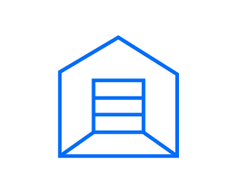


IBM Cloud Object Storage
Industry-leading flexibility, scalability, and simplicity
On-Premise
Dedicated
Public
Hybrid
Single tenant
Design-specific to client needs
Total control of system
Single tenant (compliant)
No data center space required
Flexible configuration options
OPEX vs CAPEX
Multi-tenant
Usage-based pricing
Elastic capacity
No data center space required.
Fully managed
OPEX vs CAPEX
Consistent, uniform, and open technology across on-premises, dedicated, and public cloud makes it easier and more efficient to manage data, workloads, and business processes

Slide 52
Object Storage
Public cloud services designed for today’s dynamic workloads
Frequent data access
Object Storage
Standard
Predictable data access pattern / workload
Object Storage
Vault
Less frequent data access
Object Storage Cold Vault
Minimal
data access
Variable data access pattern / Mixed workloads
Object Storage Flex
Terabytes
Capacity
Exabytes

Slide 53
VMware

Slide 54
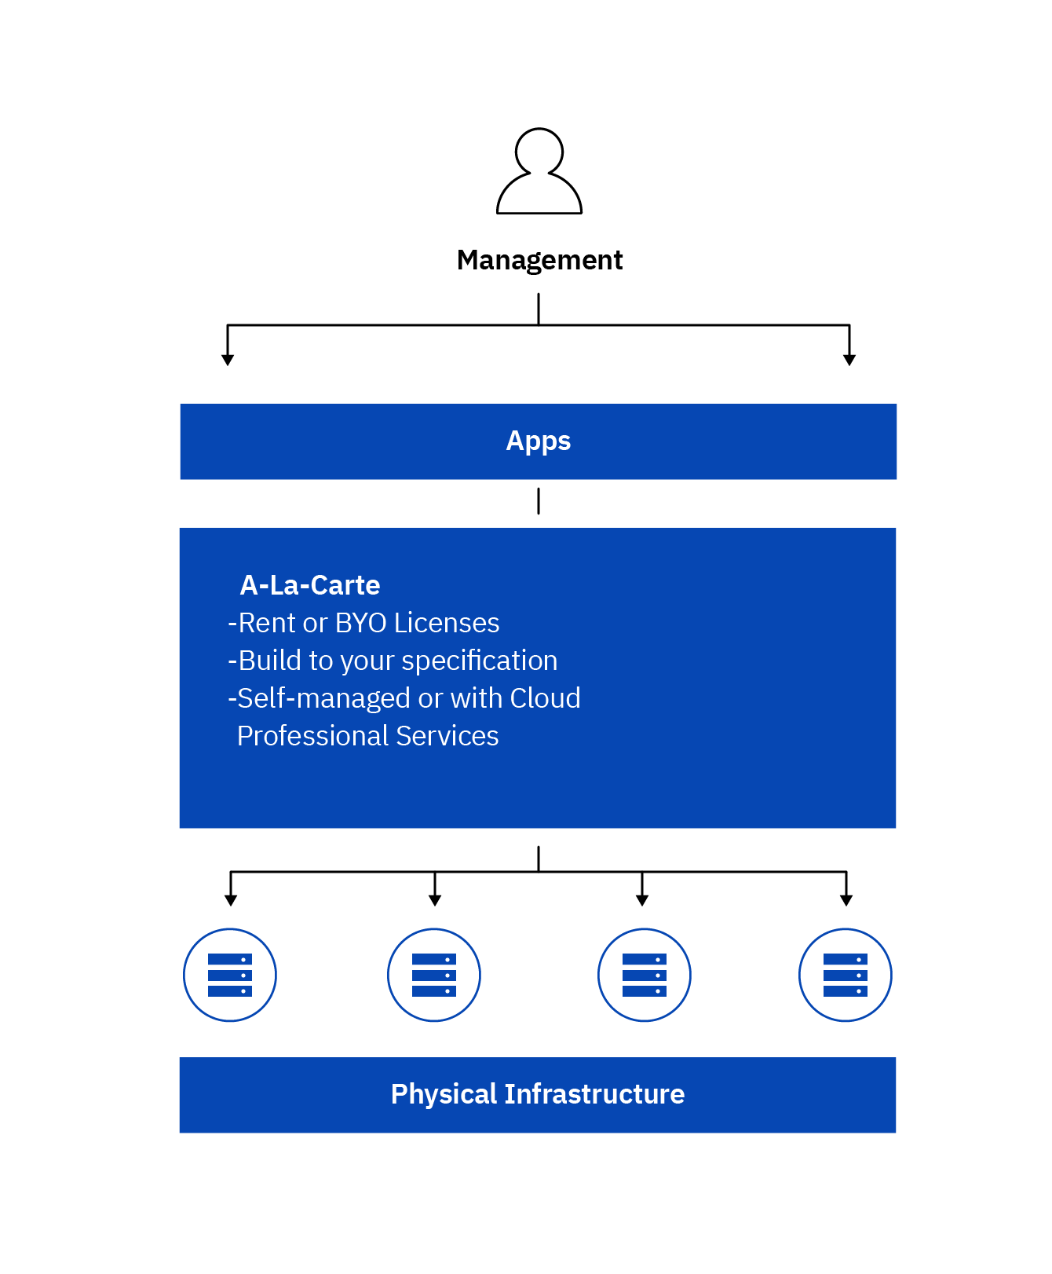
VMware vSphere® on IBM Cloud
Benefits
Purchase or bring your VMware licenses – Per CPU licensing
Build your own custom Private VMware Cloud on IBM Cloud
Manage environment to your specifications
Notes:
Details
vSphere ESXi running on Bare Metal
Customized user solution

Slide 55
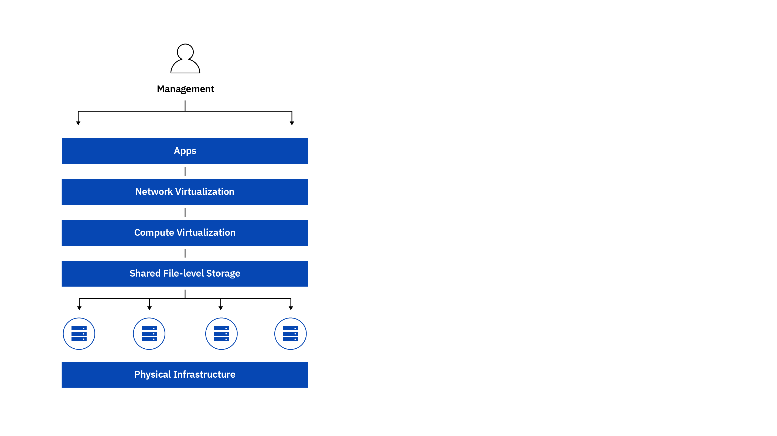
VMware vCenter Server on IBM Cloud
Benefits
Hosted private cloud with easy-to-manage logical firewall powered by NSX, dedicated IBM Cloud bare metal servers, and shared storage with data encryption at rest*
Accelerate the delivery of IT projects by reducing the time it takes for deployment of resources from weeks to hours
Easily manage workloads in the cloud using existing familiar vSphere-compatible tooling
Notes:
Details
2-node base cluster
3 Bare Metal server size options
vCenter, vSphere Enterprise Plus & NSX Base
Upgradable Memory Options
Upgradable NSX options
Add cluster

Slide 56

VMware Cloud Foundation on IBM Cloud
Benefits
Hosted Private Cloud consisting of a complete VMware SDDC with software lifecycle management
Secure, single-tenant, IBM Cloud bare metal infrastructure
Automated deployment in the cloud accelerates the delivery of IT projects
Centralized view and management of multi-site deployments
Easily manage workloads using familiar VMware products and vSphere compatible tooling
Notes:
Details
4-node base cluster
2 Bare Metal server size options
vSphere Enterprise Plus, NSX, vSAN, SCCC Manager and Active Directory
Upgradable Memory Option
Add up to 27 additional nodes

